Slide 1

INTERNSHIP BATCH 36
Final Report
IO BOX using Modbus RTU
Mentor: Nguyen Xuan Thong
Intern: Nguyen Quoc Khanh Huy

Slide 2
PROJECT REQUIREMENTS
IO BOX is 16 ports on/off controller which can read or write 16 IO ports. IO BOX controls through RS485 bus and uses Modbus RTU protocol. RS458 bus uses pair of wires increasing connection distance up to 1500m, controls up to 32 devices, via computer or IOT device.
Modbus RTU is an open serial protocol which derived from the Master/Slave architecture (Client/Server) developed by Modicon. It is a widely accepted serial level protocol due to its ease of use and reliability. Modbus RTU is widely used within Building Management Systems (BMS) and Industrial Automation Systems (IAS).
The application provides following information:
Device’s information
Manual
Scope of the work
System information

Slide 3
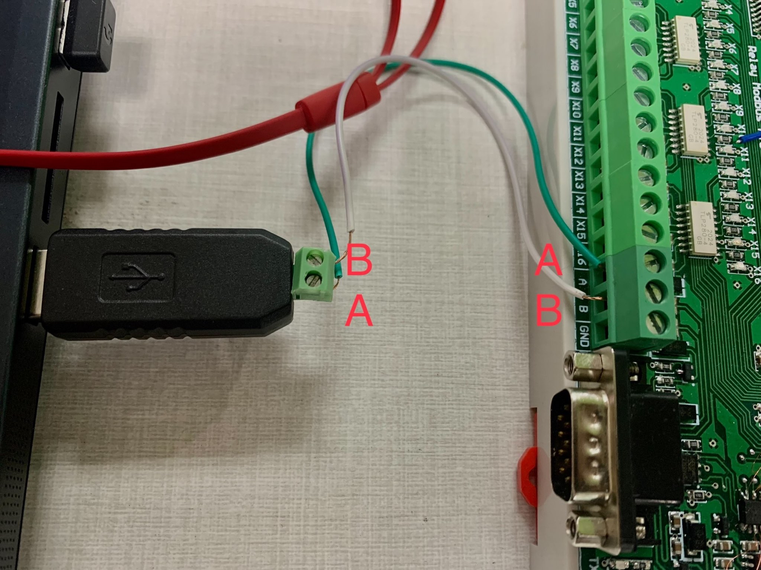
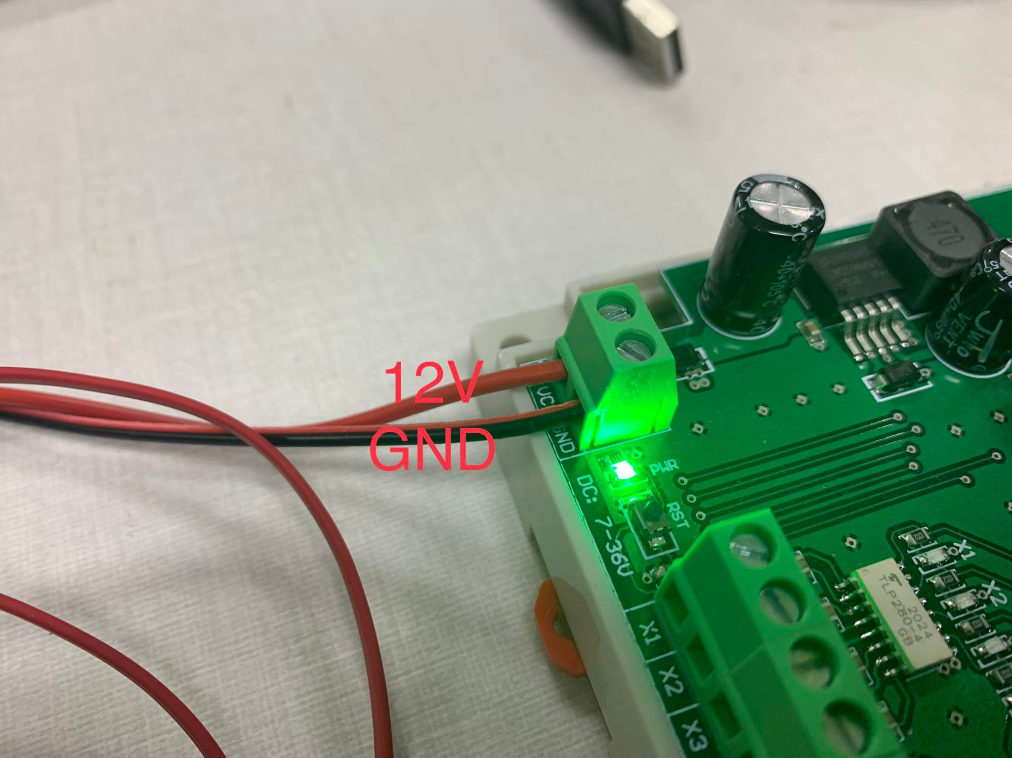
DEVICE’S INFORMATION
IO BOX consists of STM32F446RE, 16 inputs and 16 relays (ouputs)
READ VALUE
Slave id = 1 (can change id device at 539th line),
Baudrate = 115200, StartBit = 1, DataBit = 8,
CheckBit: none parity, StopBit = 1
CONNECTION
RS485 connection
Power supply connection

Slide 4
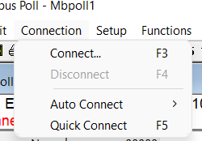
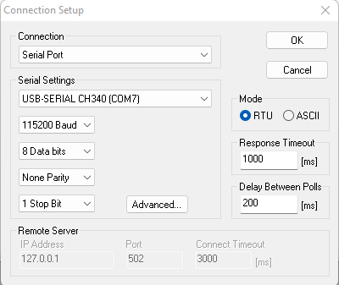
Manual
SETUP MODBUS POLL APPLICATION
Step 1: Plug & connect devices as Figure 1;
Step 2: Open Modbus Poll Software (Down here)
Step 3: Click on Connection -> Connect
Step 4: Setting up -> OK

Slide 5
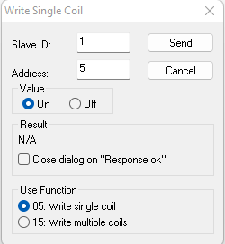
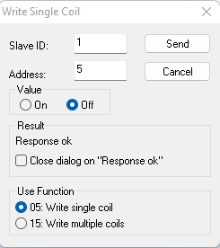
Manual
TURN ON/OFF RELAY
Step 1: Function -> Write single coil (0x05)
Step 2: set relay at 5th address to turn on/off
Turn off relay
Turn on relay

Slide 6
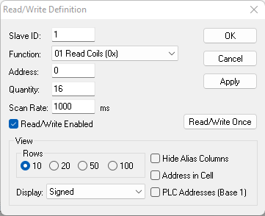
Manual
READ STATE OF RELAYS
Step 1: Setup -> Read/Write definition
Step 2: set function Read Coils (0x01) and quantity for 16 relays

Slide 7
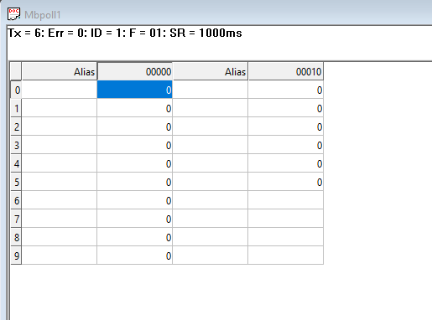
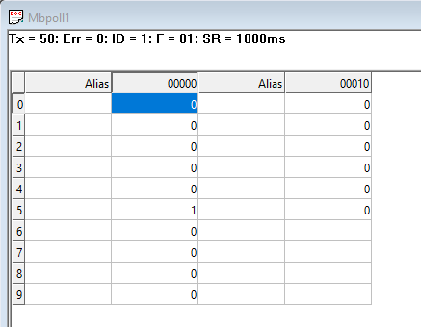
Manual
READ STATE OF RELAYS
Step 3: Follow the table to take the result.
All relays off
Relay which have 5th address,is on

Slide 8
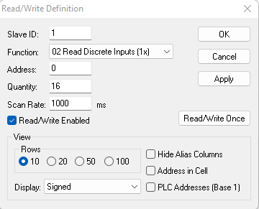
Manual
READ STATE OF INPUTS
Step 1: Setup -> Read/Write definition
Step 2: set function Read Coils (0x02) and quantity for 16 inputs

Slide 9
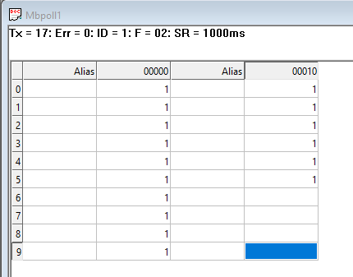
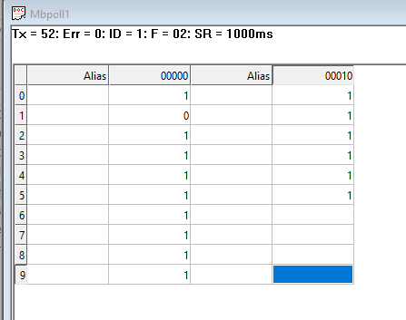
Manual
READ STATE OF RELAYS
Step 3: Follow the table to take the result.
All inputs is high
Input which have 1st address is toggle

Slide 10
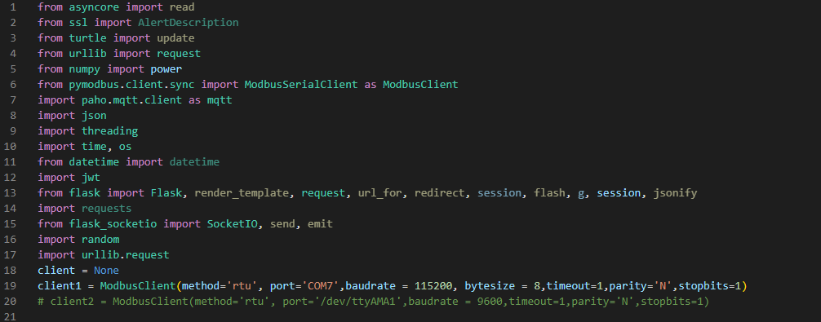
Manual
READ STATE OF INPUTS BY PYTHON
Step 1: Open vscode to run python code
Step 2: Check library and set up COM before running code
All library in python

Slide 11
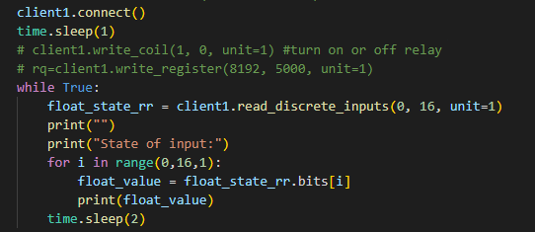
Manual
READ STATE OF INPUTS BY PYTHON
Step 3: Using read_discrete_inputs function to read the state of 16 inputs

Slide 12
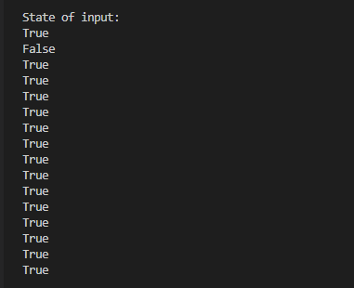
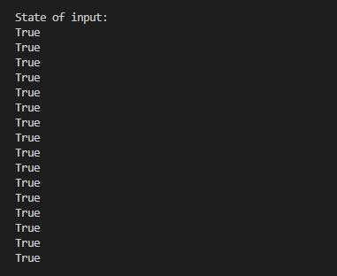
Manual
READ STATE OF INPUTS BY PYTHON
All inputs is high
Input which have 1st address is toggle

Slide 13
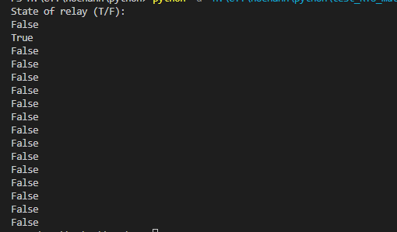
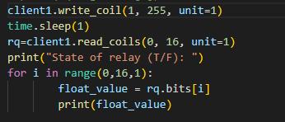
Manual
READ STATE OF RELAY BY PYTHON
Step 1: Remember install all library and set up (step 2 in READ STATE OF INPUTS BY PYTHON).
Step 2 : Using write_coil function to turn on (255)relay and read_coils function to read the state of relays
Turn on the relay which have 1st address

Slide 14
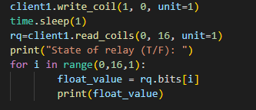
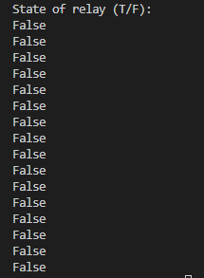
Manual
READ STATE OF RELAY BY PYTHON
Step 3 : Using write_coil function to turn off (0) relay and read_coils function to read the state of relays
Turn on the relay which have 1st address

Slide 15
Lessons learned – Best practice
Teamwork skills and work under pressure independently
Working process (manage task, control time,…).
Problem-solving skill, researching skill and time management.
Knowledge of C language and Stm32.
Try to use inheritance and linked list in C language.
Using uart and interrupt in Stm32.
Memory management and understanding of heap and stack in Stm32
Knowledge of other technology:
Design schematic and pcb with Altium Design.
Research and comprehend Modbus RTU
Using debug in KeilC.

Slide 16
Thank you

